Slide 1
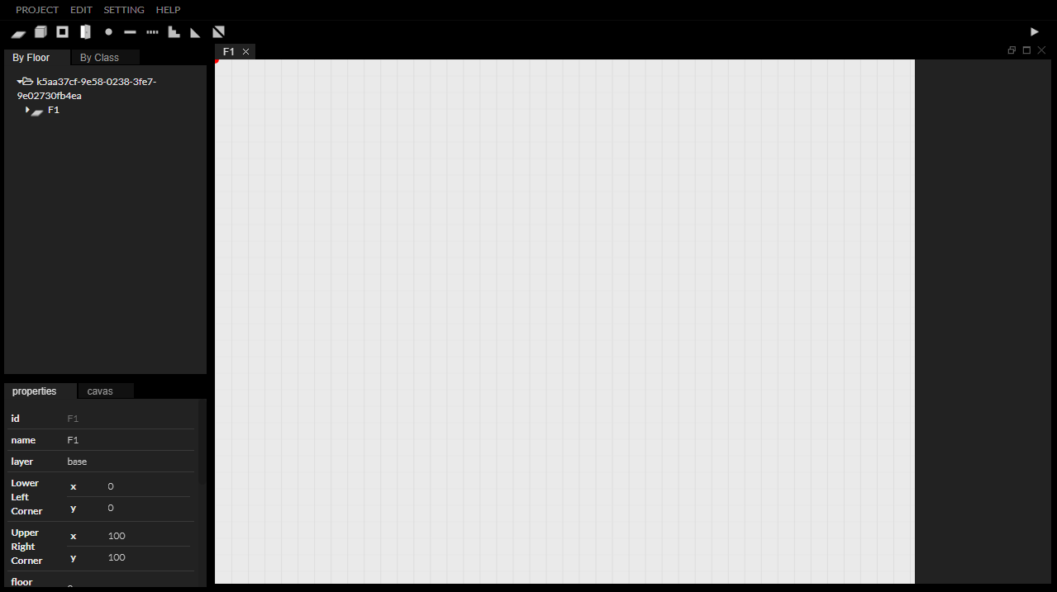
InEditor
User Guide
#4 Example
2) 5-storey building
with various moving methods

Slide 2

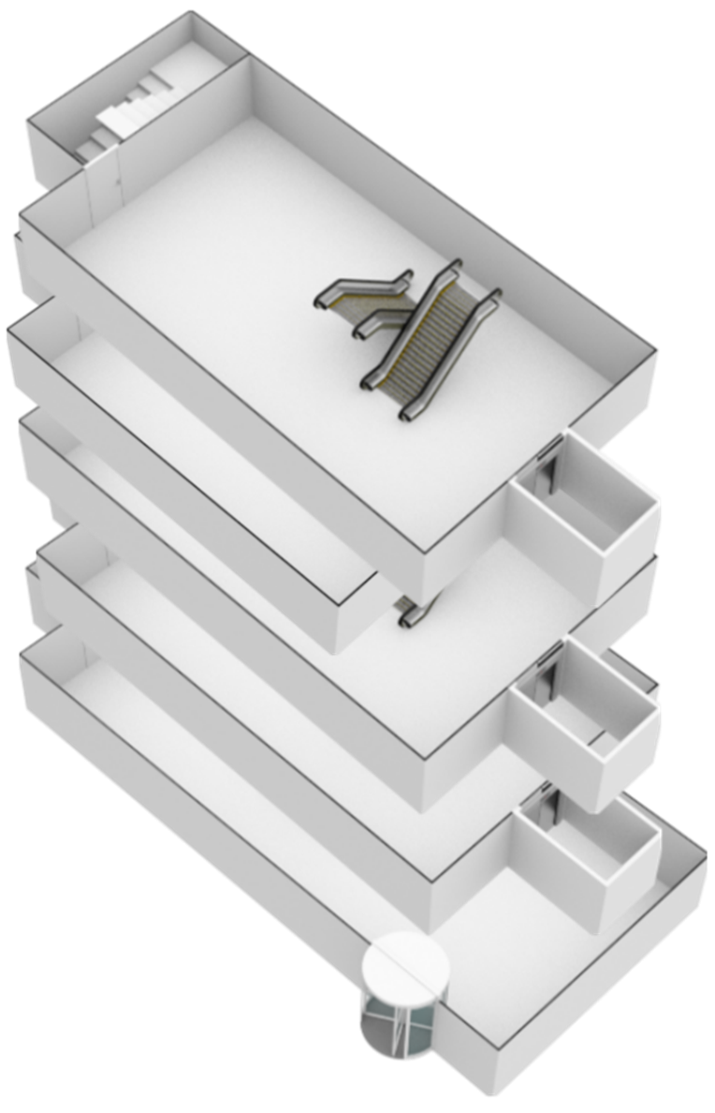
“
How to make an IndoorGML file contain stair, escalator and elevator using
InEditor?

Slide 3
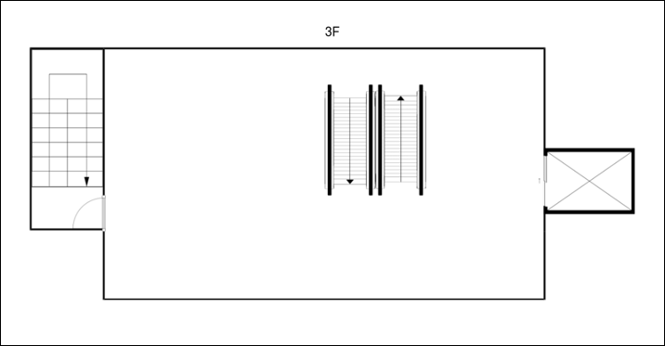
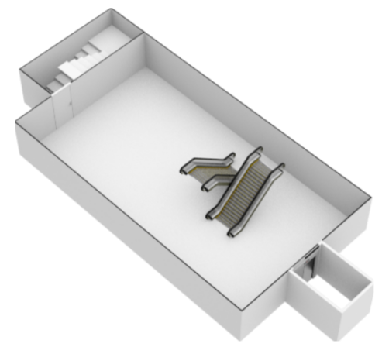
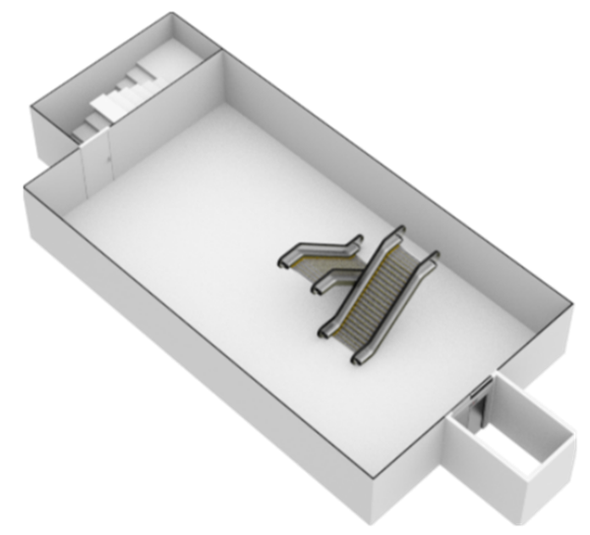
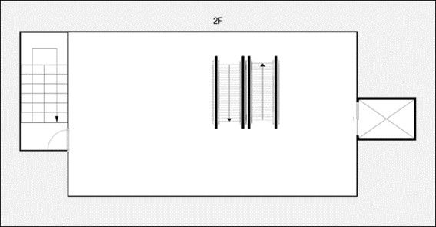
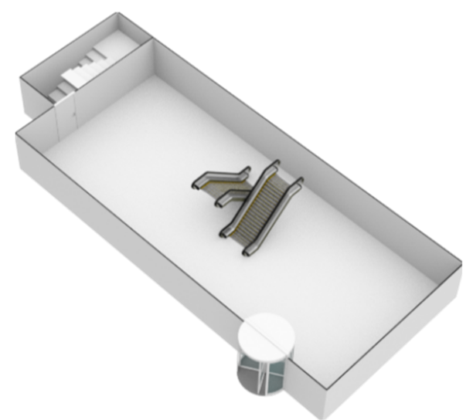
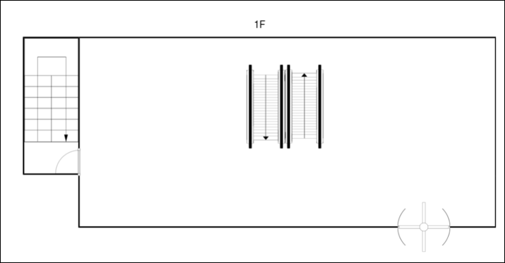
“
Goal

Slide 4

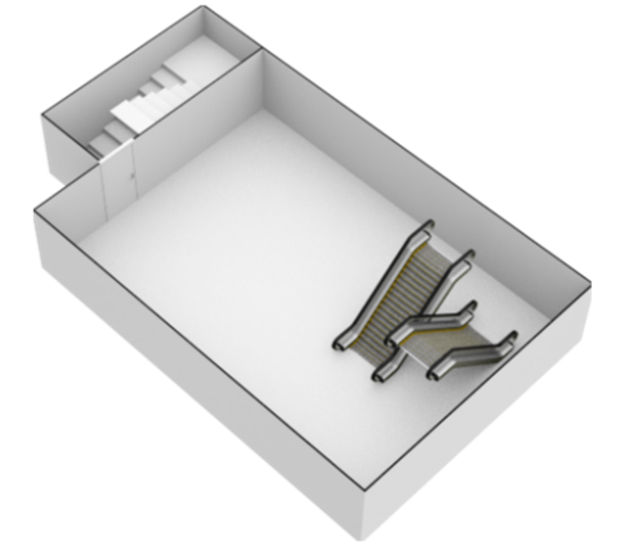
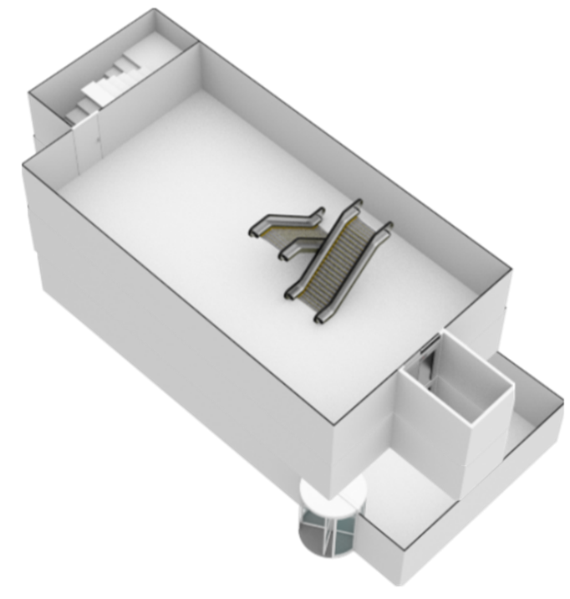
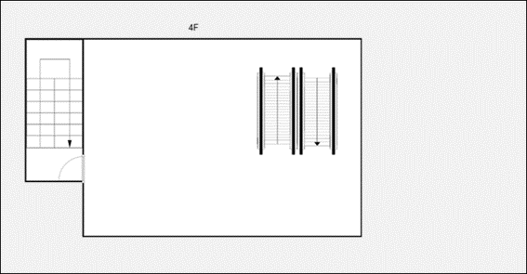
“
Goal

Slide 5



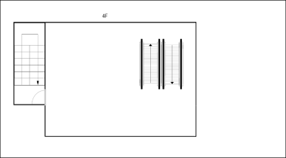

 | 1F | 2F | 3F | 4F | 5F
LLC | ( 0, 0 )
URC | ( 120, 50)
Floor height | 0 | 20 | 40 | 60 | 80
Wall height | 20
Door height | 15
“
Goal

Slide 6
Stair, Escalator and Elevator
in InEditor

Slide 7



Overview
Looking at the floor plan, there are a total of three elements that can be used by a person in the building for interlayer movement.
How to express each element is described in User Guide # 3 Case by Case. In this example, I will explain the methods with specific examples.
Stairs in a separate staircase
Elevator
Escalator

Slide 8
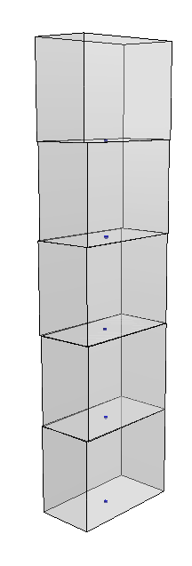
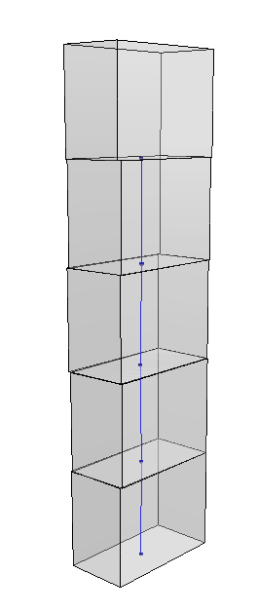
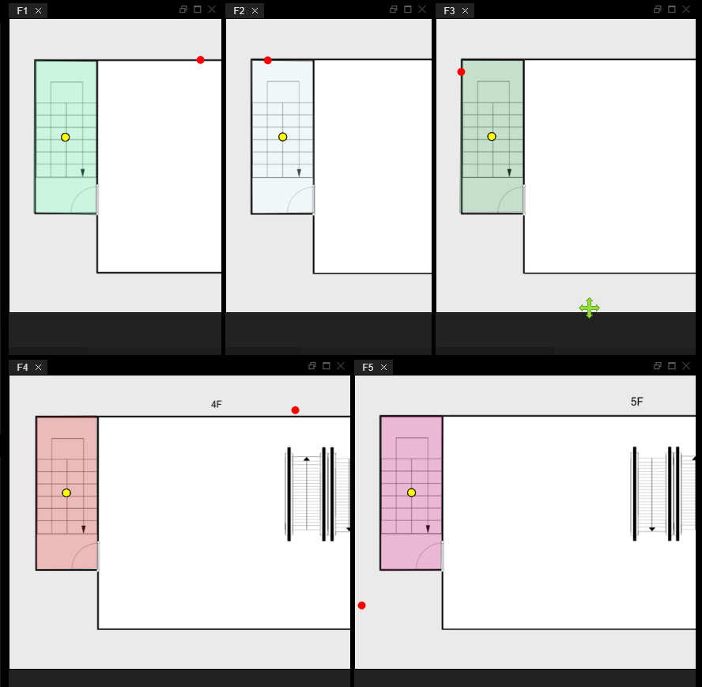

Stairs in a separate staircase
The space in the staircase can be represented by vertically contiguous CellSpace.
1F
2F
3F
4F
5F
The stairs can be expressed by the Transition(Stair) of the vertical line in that it is a vertical movement.
Stair

Slide 9
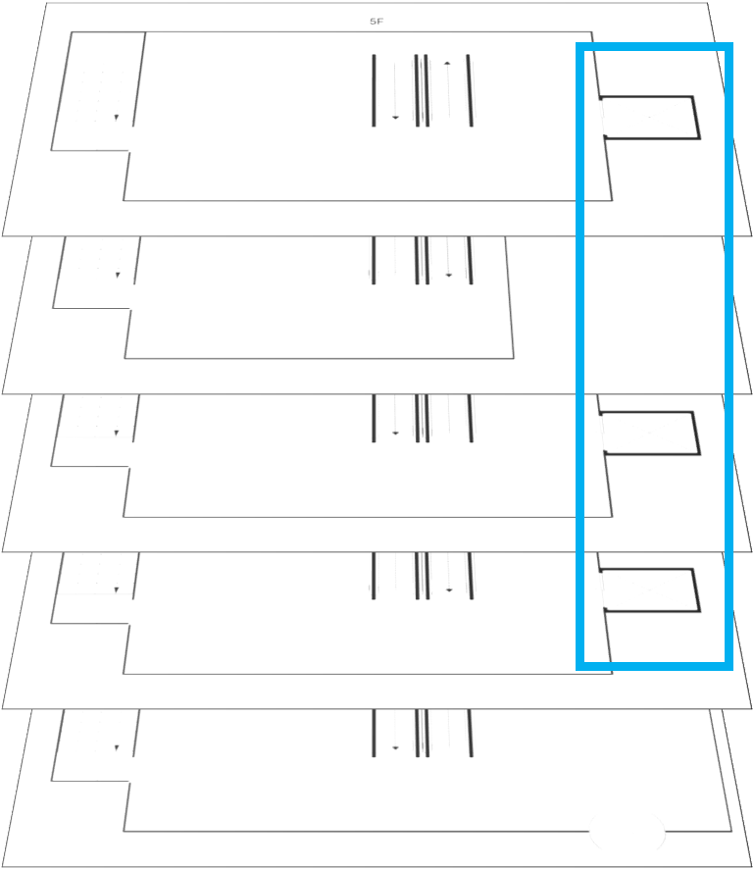
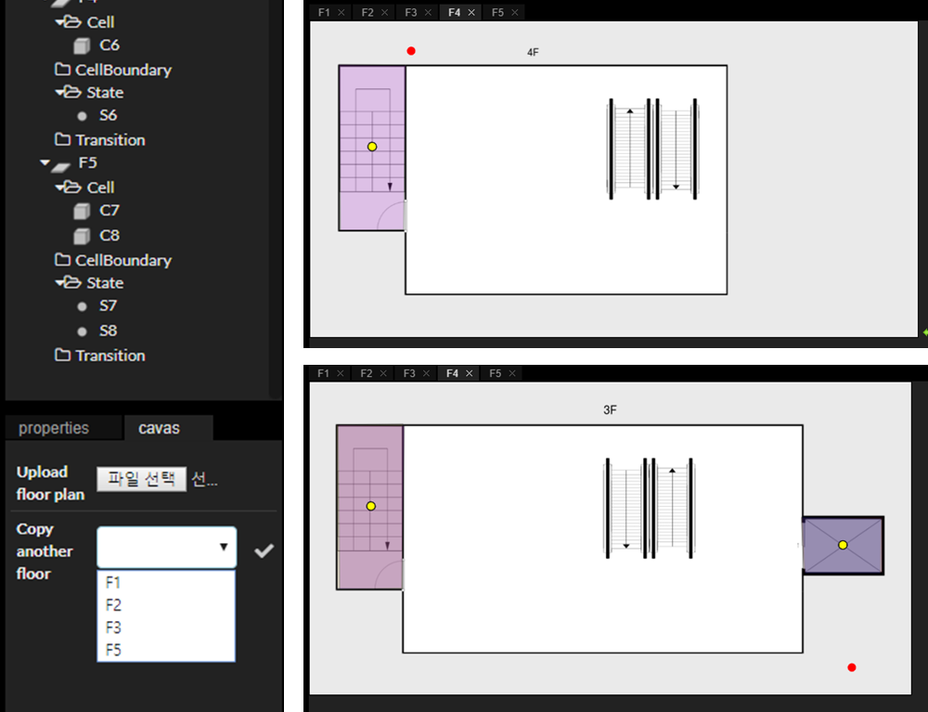
Elevator (1)
To connect the display area to the elevator, the elevator must be at 4F, even it is not displayed in the floor plan.
To determine the location of the elevator on the 4F, you can bring the current situation on the other floor to the background of the 4F.

Slide 10
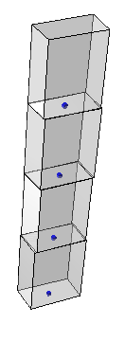
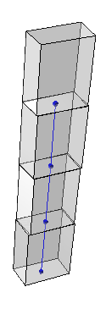
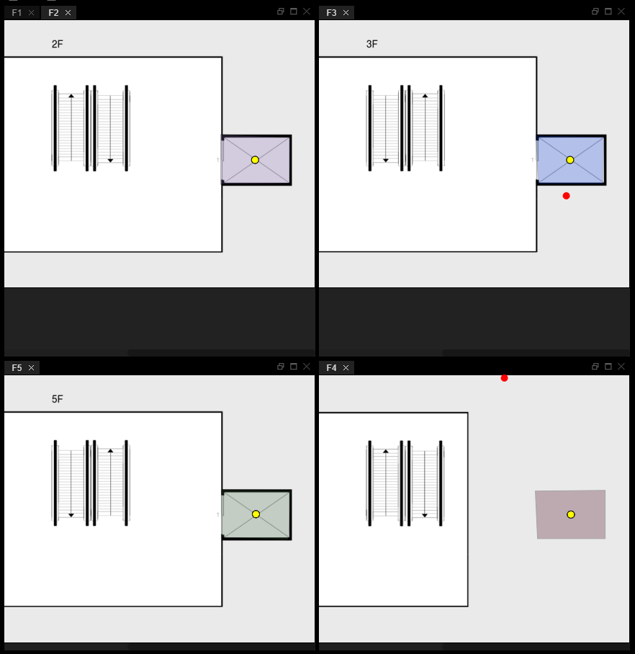
Elevator (2)
The way of expressing the elevator is the same as expressing the staircase.
The space can be represented by vertically contiguous CellSpace.
By connecting the transition between floors, the movement of the elevator is expressed.
Stair

Slide 11
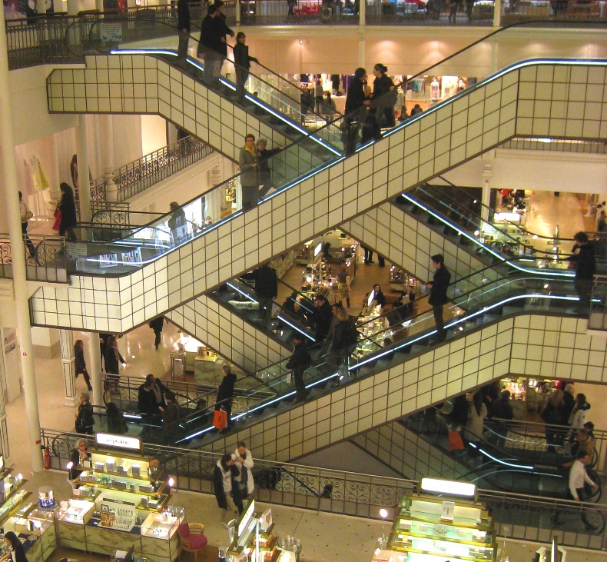
Escalator (1) - slant
The escalator can be considered to be used diagonally dividing the hexahedral space.
To express this, InEditor provides a CellSpace with a slant.

Slide 12
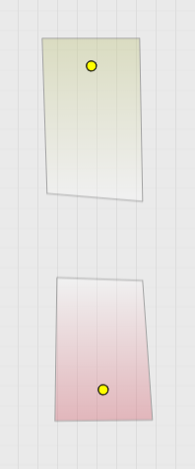
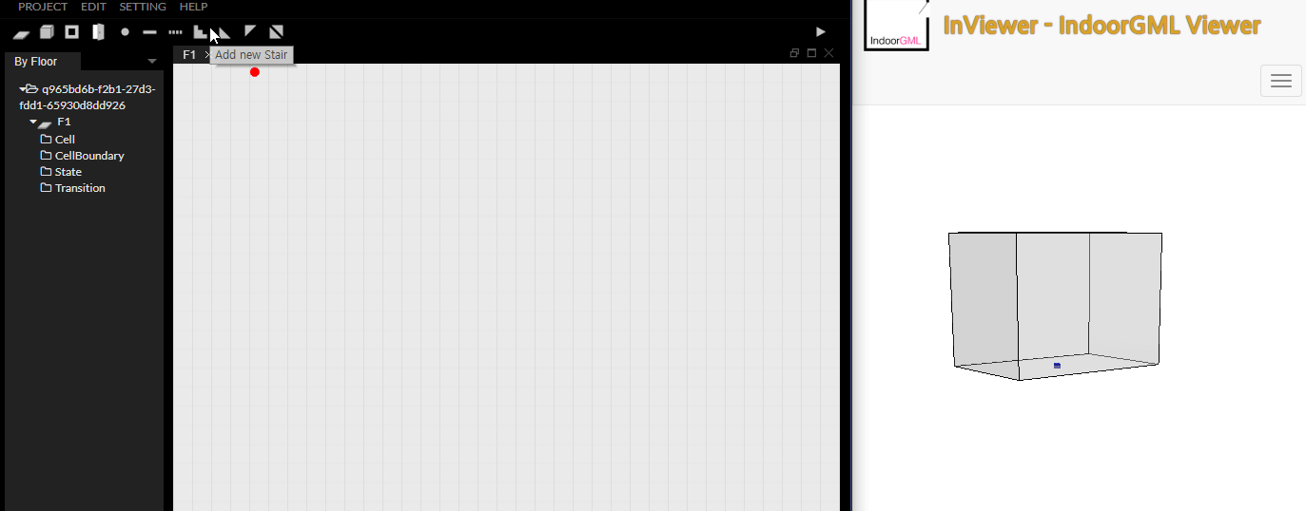
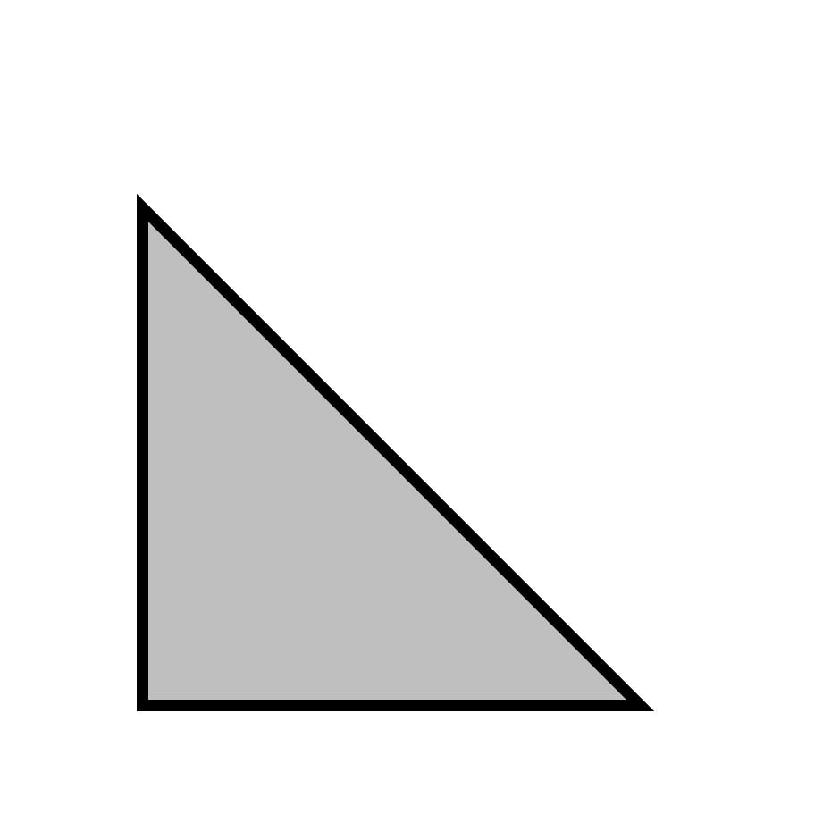
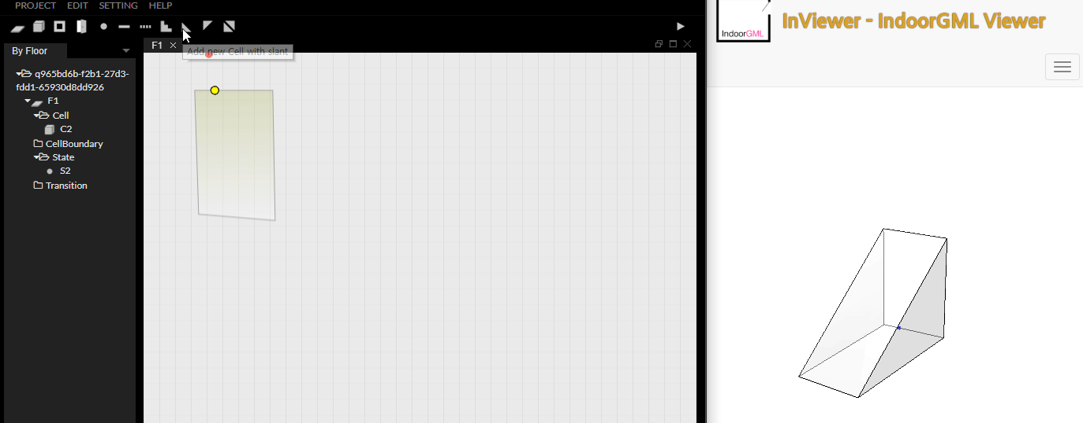
Escalator (2) – lower slant
You can start CellSpace creation with slant by pressing the button( )
The sloped CellSpace has four corners, and the sloped sides are determined by the corner selection order.
Created CellSpace is painted in gradients, unlike normal CellSpace, and the dark areas become high spots.
②
③
①
④
①
④
②
③

Slide 13
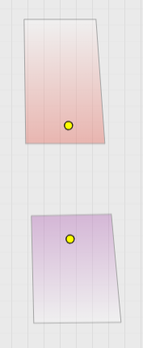
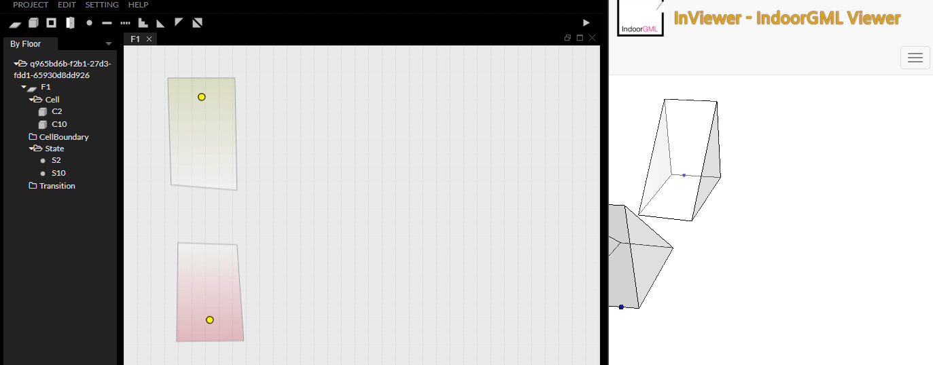
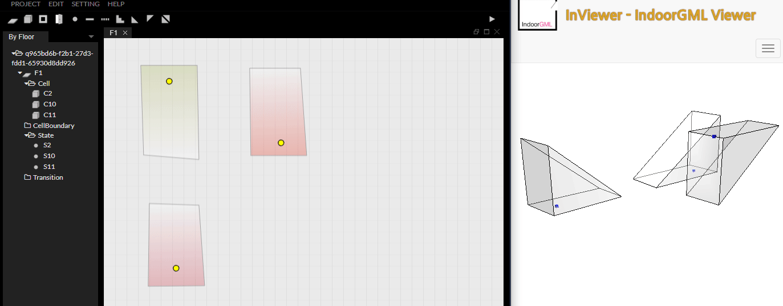
Escalator (3) – upper slant
②
③
You can start CellSpace creation with slant by pressing the button( )
The CellSpace that is created with this button is the upper side that is paired with CellSpace in the previous page.
①
④
①
④
②
③

Slide 14
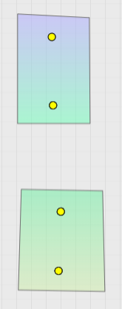
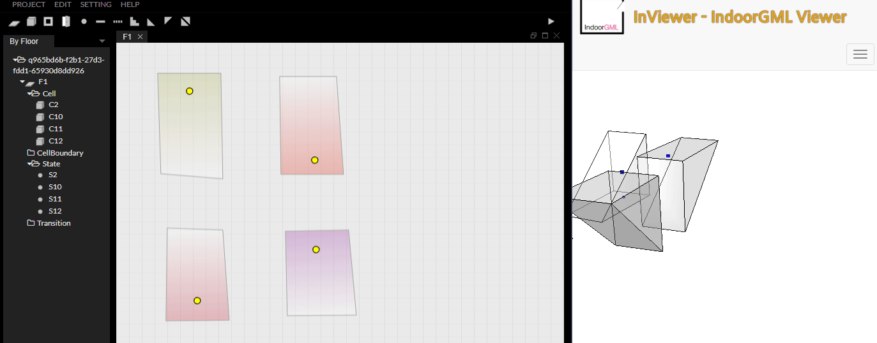

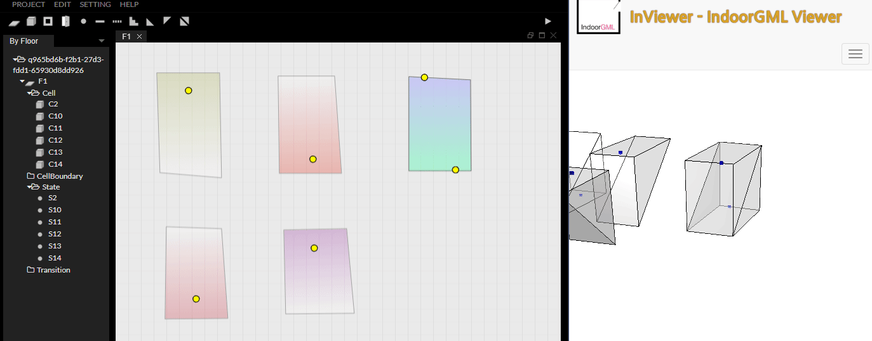
Escalator (4) – slant
②
③
You can start CellSpace creation with slant by pressing the button( )
Using this button, you can create two CellSpaces as shown above.
①
④
①
④
②
③

Slide 15
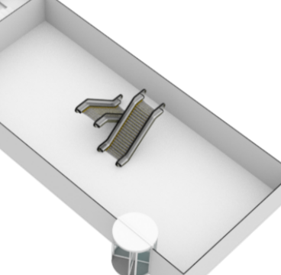
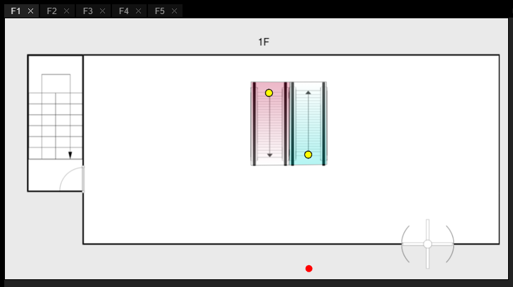
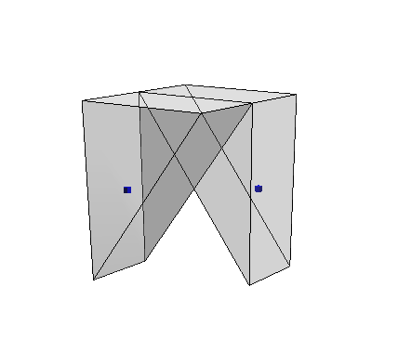
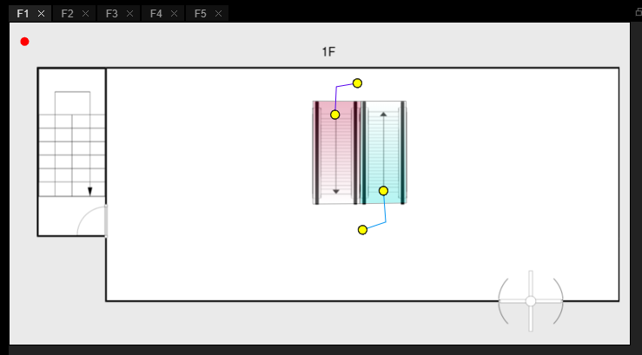
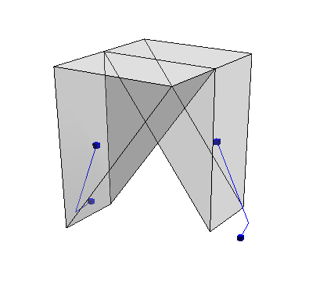
Escalator (5) - example
1F → 2F
2F → 1F

Slide 16
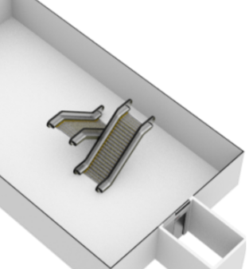
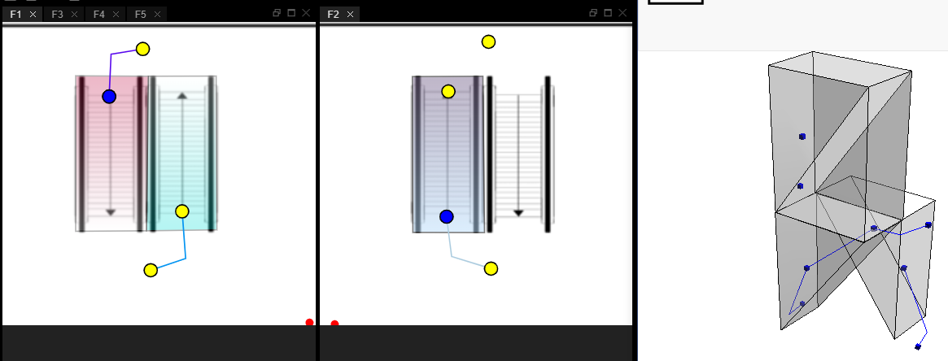
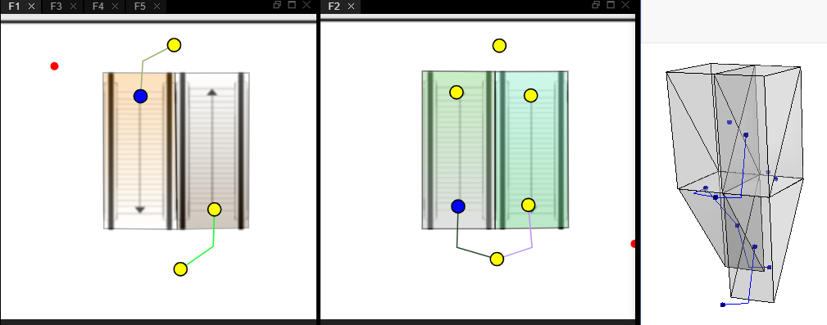
Escalator (6) - example
1F → 2F → 3F
1F → 2F → 3F
3F → 2F → 1F
Stair
Transition

Slide 17
Example

Slide 18
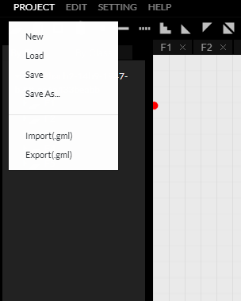
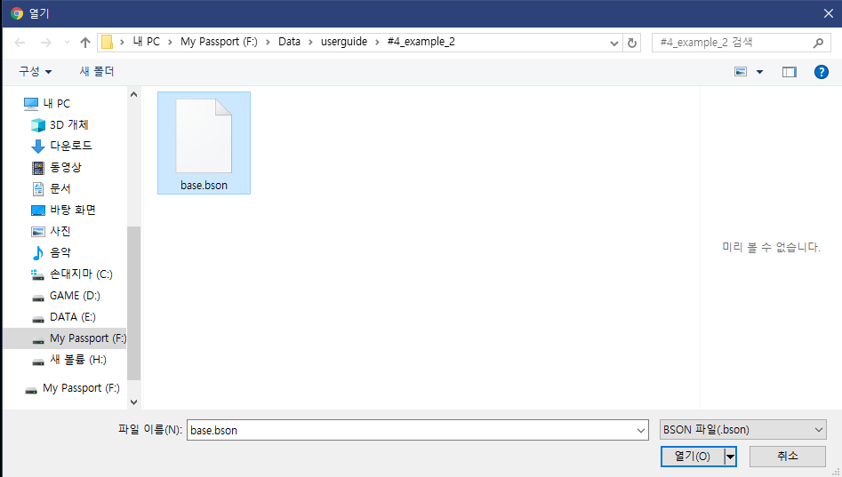
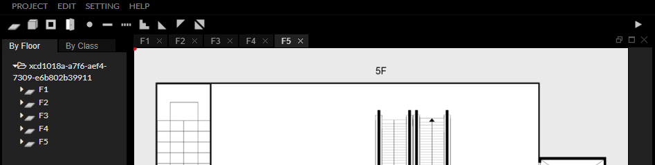
Load base.bson
Click
Project > Load
Open base.bson file.
You can get this file from InEditor github(https://github.com/STEMLab/InEditor/tree/master/Guide/UserGuide/#4_example_2)
This file contains the project with the floor plan and floor property settings.

Slide 19
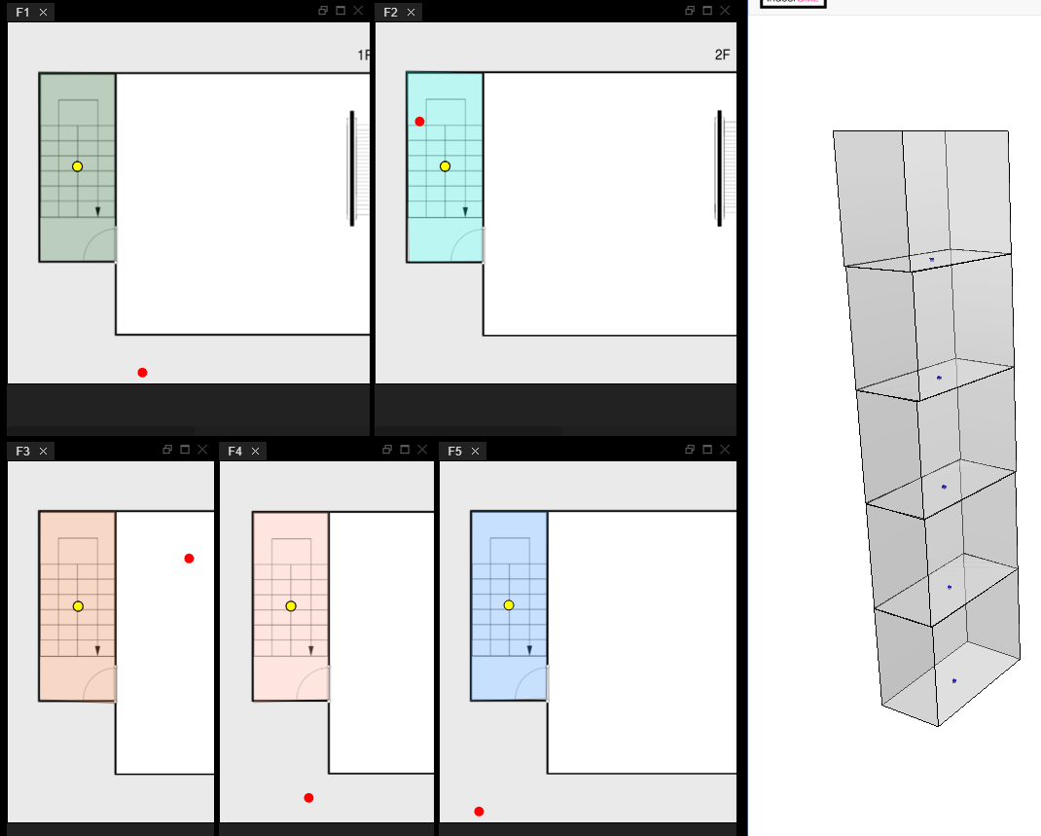
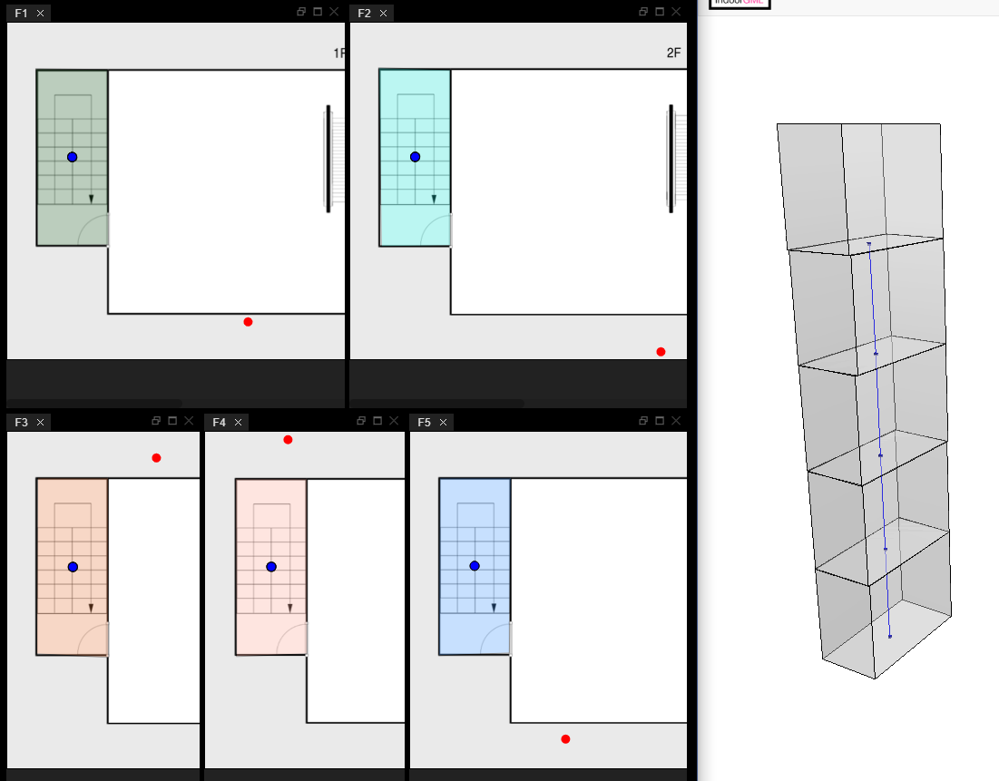
Draw staircase
Draw CellSpace(Stair) and Transition as shown in the picture.
If you do not know how to create CellSpace and Transition, see User Guide# 2 basic usage and User Guide # 4-1 exmple1.
CellSpace
Stair

Slide 20
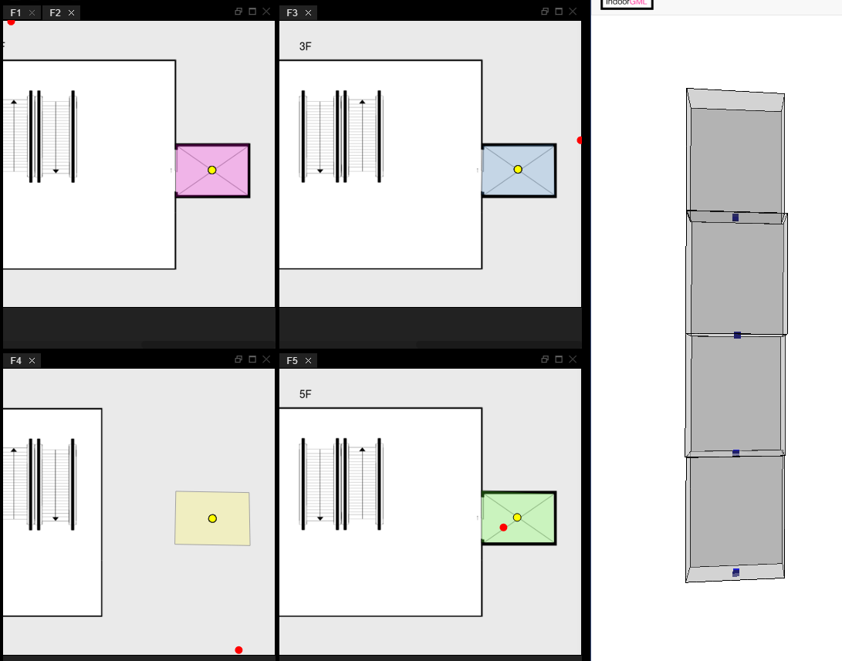
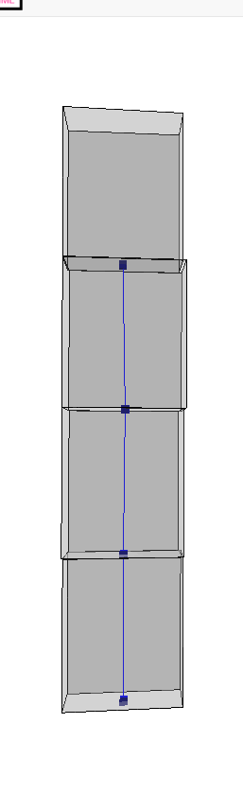
Draw elevator
Draw CellSpace(Stair) and Transition as shown in the picture.
CellSpace
Stair

Slide 21
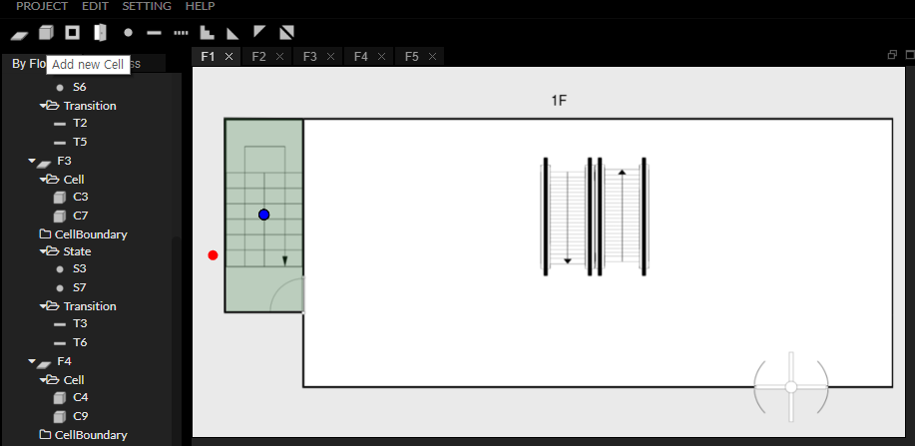
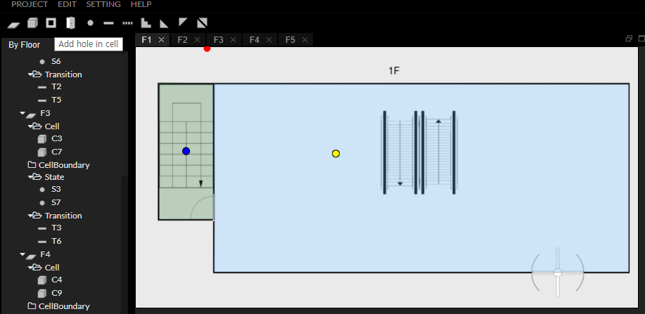
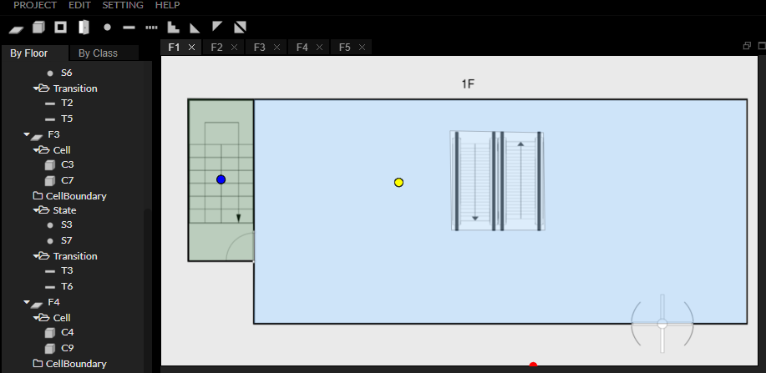
Draw corridor of each floor (1)
In the center of the corridor, an empty space is required for the escalator. Draw a cell space for each layer and add a hole to create an empty space.
If you do not know how to create Hole, see User Guide# 2 basic usage.
CellSpace
Hole

Slide 22
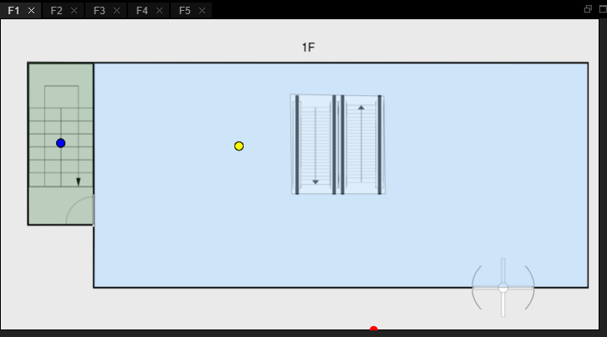





Draw corridor of each floor (2)

Slide 23




Draw corridor of each floor (3)

Slide 24



Draw escalator
Draw a CellSpace, paying attention to the direction of the slant, as we did in the example above. The position and height of the state are changed flexibly and appropriately.
In this example, the height of the state of the escalator was adjusted with the following rules.
Located in 1F : 10
2F or more and connected to the lower floor : 0
2F or more and connected to the upper layer : 10

Slide 25




Draw escalator

Slide 26

Add the transition between escalator and corridor
Figure 1
Figure 2
If you create the Transitions based on the distribution of the current States, you can see Figure 1.
However, in general, the path of a person moving on an escalator is close to Figure 2.
On the next page, we will add a sub layer to represent a fine network like Figure 2.

Slide 27
Sub layer (1)
Elevator
Stair
Corridor
Base Layer
Sub Layer
Escalator
We will separate the escalator area
from the existing base layer
into the sublayer.

Slide 28



Sub layer (2) – Load sublayer.bson and create sub laeyer
Sublayer.bson : ‘Draw elevator' has been completed.
Create five more floors for sublayer.
Set each layer property to ‘sub’, fill properties value to properly and copy original floor as the background of sublayer.

Slide 29

Sub layer (3) - Draw escalator on sublayer

Slide 30

Sub layer (3) – Add states for fine network

Slide 31



Sub layer (3) – Add transition

Slide 32


Sub layer (3) – Add InterlayerConnection
Add InterlayerConnection between base layer and sub layer.
InterlayerConnection

Slide 33

Add Transitions and States on base layer

Slide 34




Export to IndoorGML
1. Click Project > Export(.gml)
4. Download gml file
2. Enter the values in modal.
Select export options.
3. Click Export button

Slide 35
Thank You

